Slide 1
Správa procesov a I/O
doc. Ing. Július BARÁTH, PhD.
Katedra Informatiky
Akadémia ozbrojených síl
e-mail: julius.barath@aos.sk

Slide 2
Osnova
Procesor a proces
techniky prideľovania procesoru
cyklické plánovanie
prioritné plánovanie
kombinované plánovanie
Ovládanie periférií

Slide 3
Procesor a proces
podmienky existencie procesu:
riadiaci program
realizujúci procesor
existencia procesu - v jadre OS blok PCB - riadiaci blok procesu (stav procesu, pridelenie pamäti a pod.)
procesy vznikajú a zanikajú dynamicky

Slide 4
Procesor a proces
správa procesov
operácie s procesmi (zastav proces, obnov proces, vytvor proces, koniec procesu)
správa (prideľovanie) procesoru
časový front
synchronizácia procesov (aktivuj proces, zablokuj proces)
stavy procesu
Nový
Bežiaci
Čakajúci
Pripravený
ukončený

Slide 5

Diagram of Process State

Slide 6
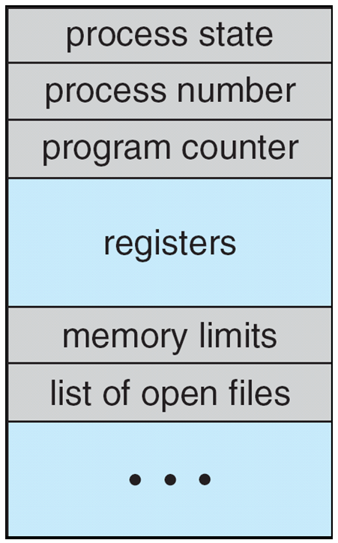
Process Control Block (PCB)
Information associated with each process
(also called task control block)
Process state – running, waiting, etc
Program counter – location of instruction to next execute
CPU registers – contents of all process-centric registers
CPU scheduling information- priorities, scheduling queue pointers
Memory-management information – memory allocated to the process
Accounting information – CPU used, clock time elapsed since start, time limits
I/O status information – I/O devices allocated to process, list of open files

Slide 7
Basic Concepts of CPU Scheduling
Maximum CPU utilization obtained with multiprogramming
CPU–I/O Burst Cycle – Process execution consists of a cycle of CPU execution and I/O wait
CPU burst followed by I/O burst
CPU burst distribution is of main concern

Slide 8
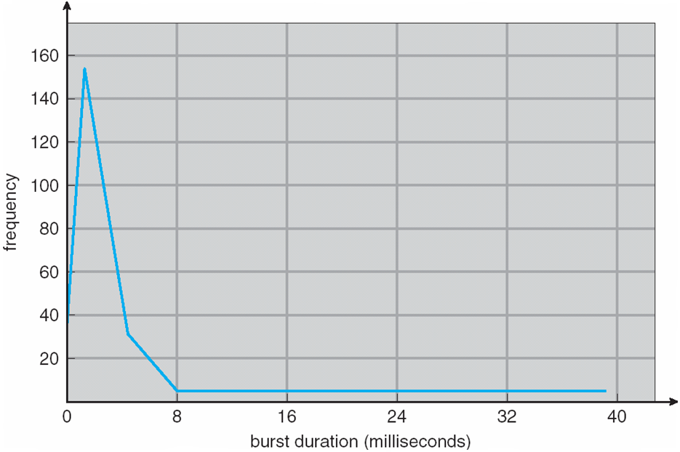
Histogram of CPU-burst Times

Slide 9
CPU Scheduler
Short-term scheduler selects from among the processes in ready queue, and allocates the CPU to one of them
Queue may be ordered in various ways
CPU scheduling decisions may take place when a process:
Switches from running to waiting state
Switches from running to ready state
Switches from waiting to ready
Terminates
Scheduling only under 1 and 4 is nonpreemptive
Under nonpreemptive scheduling, once the CPU has been allocated to a process, the process keeps the CPU until it releases the CPU either by terminating or by switching to the waiting state
All other scheduling is preemptive
Consider access to shared data
Consider preemption while in kernel mode
Consider interrupts occurring during crucial OS activities

Slide 10
Dispatcher
Dispatcher module gives control of the CPU to the process selected by the short-term scheduler; this involves:
switching context
switching to user mode
jumping to the proper location in the user program to restart that program
The dispatcher should be as fast as possible, since it is invoked during every process switch
Dispatch latency – time it takes for the dispatcher to stop one process and start another running

Slide 11
Scheduling Criteria
MAXIMIZE
CPU utilization – keep the CPU as busy as possible
Throughput – # of processes that complete their execution per time unit
MINIMIZE
Turnaround time – amount of time to execute a particular process
Waiting time – amount of time a process has been waiting in the ready queue
Response time – amount of time it takes from when a request was submitted until the first response is produced, not output (for time-sharing environment)

Slide 12
Cyklické plánovanie
použitie pri viacpoužívateľských OS
všetky virtuálne procesory sú rovnako výkonné
procesor je pridelený na pevný časový interval
na odobratie procesora prepínanie kontextu
výber procesov plánovacou stratégiou FIFO
dĺžka časového intervalu X čas potrebný na prepnutie kontextu
dĺžka časového intervalu
konštantná
premenlivá (podľa priority)

Slide 13
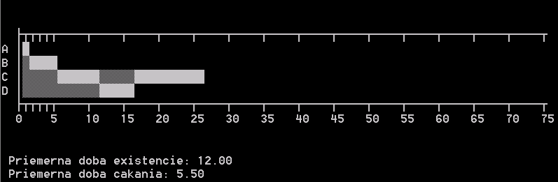
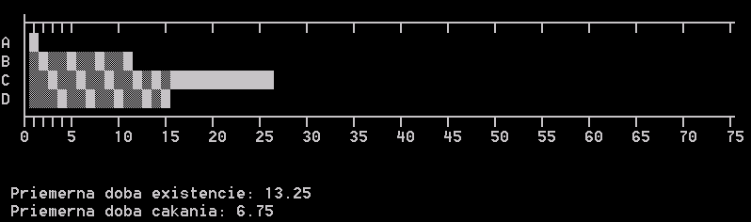
Cyklické plánovanie I.
priemerná doba existencie procesu kratšia
t_{e}=(1+5+26+16)/4=12
Priemerná doba odozvy dlhšia
t_{č}=(0+1+10+11)/4=5,5
kvantum =6 vs kvantum=1
Procesy sa nachádzajú pre zjednodušenie len v stavoch:
pripravený
bežiaci

Slide 14
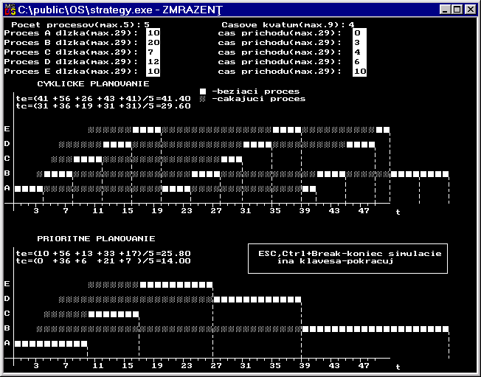
Iné príklady

Slide 15
Prioritné plánovanie
prednosť na základe priradenia priority (číselná hodnota)
možný problém - starnutie procesov s nižšími prioritami
riešenie problému - dynamická zmena priority
je potrebné upraviť prepínanie kontextu - pri každom zápise do fronty pripravených procesov (zápis procesu s vyššou prioritou)

Slide 16
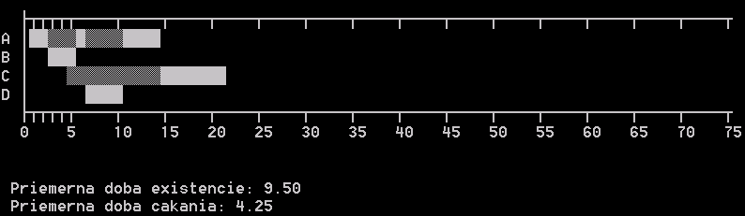
Prioritné plánovanie II.
Procesy A,B,C,D vznikli v časoch 0,2,4,6 a priorita je daná odhadom celkovej doby behu procesu
SJF - Short Job First

Slide 17
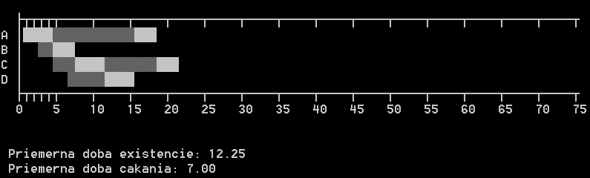
Porovnanie prioritného a cyklického plánovania
Cyklické s kvantom = 4 (optimum)

Slide 18
Kombinovaná plánovacia stratégia
prístup 1.
Kombinácia prioritnej a cyklickej plánovacej stratégie:
vyššie číslo, nižšia priorita
prioritná stratégia sa uplatňuje na prvých K úrovniach
cyklické plánovanie na úrovniach nižších než K
platí, že každá úroveň má vlastnú frontu pripravených procesov
prístup 2.
Dlhší beh - nižšia priorita - dlhší časový interval
dôsledok - zníženie réžie pri prepínaní kontextu u dlho bežiacich procesov

Slide 19
Plánovanie procesov a úloh
preemptívne plánovanie
metódy a stratégie umožňujúce pozastavenie behu procesu
prepnutie buď pri vyčerpaní časového kvanta
prepnutie pri príchode úlohy s vyššou prioritou (RT)
preemcia - príležitosť pre naliehavé procesy
bez preemcie
neumožňuje odobratie procesora akt. procesu
zabraňuje vzniku časovo závislých chýb
problémy pri náročných a dlhých programoch

Slide 20
Ďalšie plánovacie stratégie
Július Baráth:
J.J.Donovan: Operační systémy
podľa využitia časového kvanta
ak proces využije celé kvantum - zaradený na koniec frontu pripr. procesov
ak využije 1/2 kvanta (I/O) - zaradený do prostriedku frontu pripravených procesov
vhodné pre aplikácie s veľkými požiadavkami na I/O
cyklická obsluha so SV
ak procesor prideľovaný novému procesu - 1x dostane toľko kvánt, koľko bolo pridelené každému ostatnému proc. vo fronte
potom prideľovanie cyklicky

Slide 21
Ďalšie plánovacie stratégie
rešpektovanie vyváženosti systému
prednosť majú procesy s veľkými nárokmi na I/O
sleduje sa efektívne využitie PZ
limitovaná cyklická obsluha
cyklické prideľovanie do vyčerpania časového limitu
po vyčerpaní obslúžené len vtedy, ak v systéme nie sú žiadne úlohy
stratégia preferujúca interakt. prístup
ak používateľ komunikuje s procesom - pridelený procesor
cieľ: dosiahnutie čo najkratšej doby odozvy

Slide 22
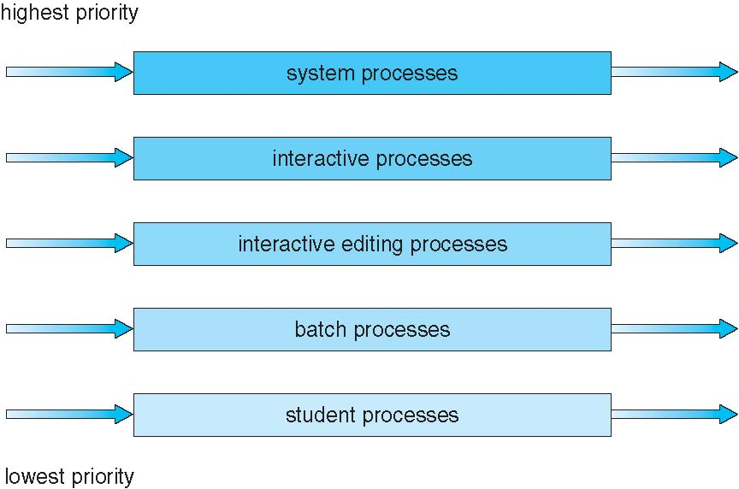
Multilevel Queue Scheduling
partitions the ready queue into several separate queues
Each queue has absolute priority over lower-priority queues

Slide 23
Multiple-Processor Scheduling
CPU scheduling more complex when multiple CPUs are available
Homogeneous (identical) processors within a multiprocessor
Asymmetric multiprocessing – only one processor accesses the system data structures, alleviating the need for data sharing
The other processors execute only user code
Symmetric multiprocessing (SMP) – each processor is self-scheduling, all processes in common ready queue, or each has its own private queue of ready processes
Currently, most common
Processor affinity – process has affinity for processor on which it is currently running (think about L1, L2 cache content, NUMA)
soft affinity (system attempts but not guarantee)
hard affinity
Variations including processor sets

Slide 24
NUMA and CPU Scheduling
Note that memory-placement algorithms can also consider affinity

Slide 25
Multiple-Processor Scheduling – Load Balancing
If SMP, need to keep all CPUs loaded for efficiency
Load balancing attempts to keep workload evenly distributed
Push migration – periodic task checks load on each processor, and if found pushes task from overloaded CPU to other CPUs
Pull migration – idle processors pulls waiting task from busy processor

Slide 26
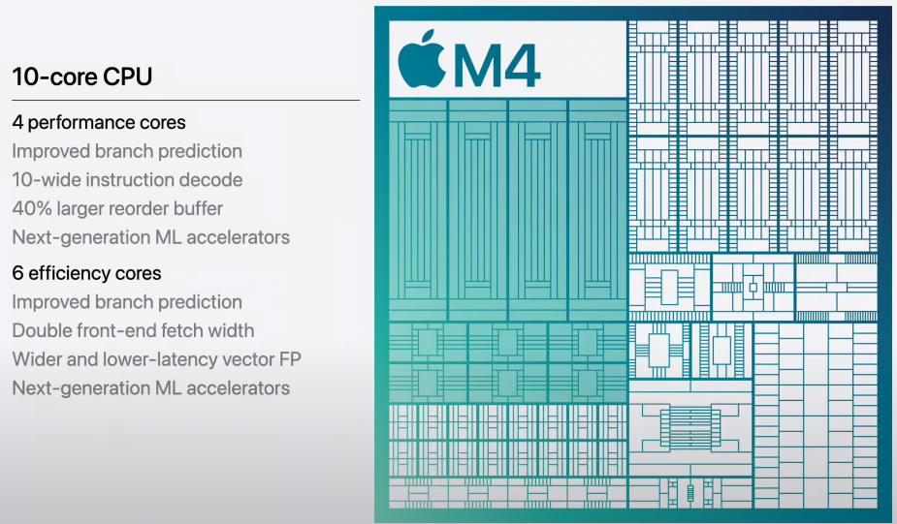
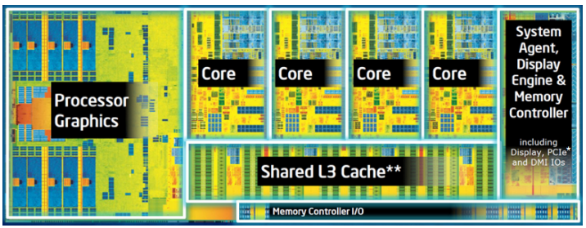
Multicore Processors
Recent trend to place multiple processor cores on same physical chip
Faster and consumes less power
Multiple threads per core also growing
Takes advantage of memory stall to make progress on another thread while memory retrieve happens
Intel Core i7, Apple M4 example
Notes:
Zdroj: White Paper: Introduction to Intel® Architecture, The Basics

Slide 27
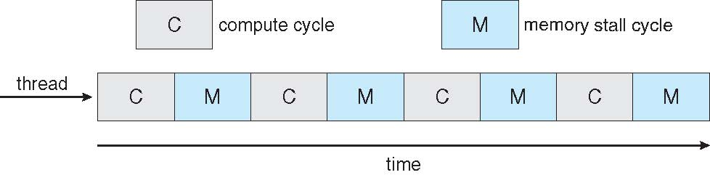

Multithreaded Multicore System
when a processor accesses memory, it spends a significant amount of time waiting for the data to become available. This situation, known as a memory stall 50% of time
To remedy this situation, many recent hardware designs have implemented multithreaded processor cores in which two (or more) hardware threads are assigned to each core.

Slide 28
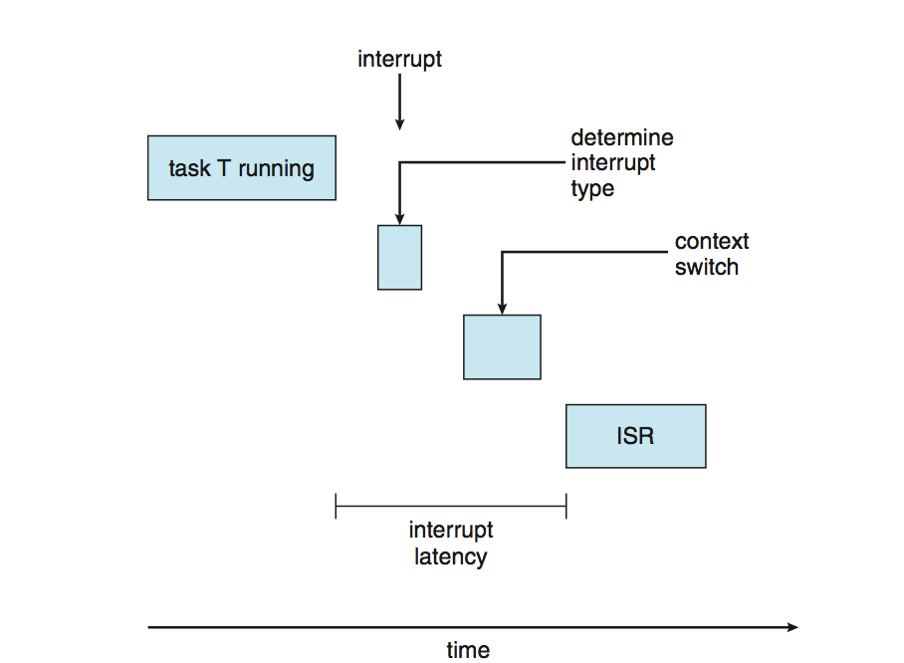
Real-Time CPU Scheduling
Can present obvious challenges
Soft real-time systems – no guarantee as to when critical real-time process will be scheduled
Hard real-time systems – task must be serviced by its deadline
Two types of latencies affect performance
Interrupt latency – time from arrival of interrupt to start of routine that services interrupt
Dispatch latency – time for schedule to take current process off CPU and switch to another

Slide 29
Virtualization and Scheduling
Virtualization software schedules multiple guests onto CPU(s)
Each guest doing its own scheduling
Not knowing it doesn’t own the CPUs
Can result in poor response time
Can effect time-of-day clocks in guests
Can undo good scheduling algorithm efforts of guests

Slide 30
Linux Scheduling Completely Fair Scheduler (CFS)
Scheduling classes
Each has specific priority
Scheduler picks highest priority task in highest scheduling class
quantum based on proportion of CPU time
2 scheduling classes included, others can be added
default
real-time
Quantum calculated based on nice value from -20 to +19
Lower value is higher priority
Calculates target latency – interval of time during which task should run at least once
Target latency can increase if say number of active tasks increases
CFS scheduler maintains per task virtual run time in variable vruntime
Associated with decay factor based on priority of task – lower priority is higher decay rate
Normal default priority yields virtual run time = actual run time
To decide next task to run, scheduler picks task with lowest virtual run time

Slide 31
Windows priority-based preemptive scheduling
Highest-priority thread runs next
Real-time threads can preempt non-real-time
Thread runs until (1) blocks, (2) uses time slice, (3) preempted by higher-priority thread
32-level priority scheme
Priority 0 is memory-management thread
Variable class is 1-15, real-time class is 16-31
Queue for each priority
If no run-able thread, runs idle thread

Slide 32
Windows Priority Classes
Win32 API identifies several priority classes to which a process can belong
REALTIME_PRIORITY_CLASS, HIGH_PRIORITY_CLASS, ABOVE_NORMAL_PRIORITY_CLASS,NORMAL_PRIORITY_CLASS, BELOW_NORMAL_PRIORITY_CLASS, IDLE_PRIORITY_CLASS
All are variable except REALTIME
A thread within a given priority class has a relative priority
TIME_CRITICAL, HIGHEST, ABOVE_NORMAL, NORMAL, BELOW_NORMAL, LOWEST, IDLE
Priority class and relative priority combine to give numeric priority
Base priority is NORMAL within the class
If quantum expires, priority lowered, but never below base
If wait occurs, priority boosted depending on what was waited for
Foreground window given 3x priority boost
Windows 7 added user-mode scheduling (UMS)
Applications create and manage threads independent of kernel
For large number of threads, much more efficient
UMS schedulers come from programming language libraries like C++ Concurrent Runtime (ConcRT) framework

Slide 33
Windows Priorities
priority classes
relative priority

Slide 34
Ovládanie periférií

Slide 35
Overview
I/O management is a major component of operating system design and operation
Important aspect of computer operation
I/O devices vary greatly
Various methods to control them
Performance management
New types of devices frequent
Ports, busses, device controllers connect to various devices
Device drivers encapsulate device details
Present uniform device-access interface to I/O subsystem

Slide 36
I/O Hardware
Incredible variety of I/O devices
Storage
Transmission
Human-interface
Common concepts – signals from I/O devices interface with computer
Port – connection point for device (serial port, USB port)
Bus - daisy chain or shared direct access
PCI bus common in PCs and servers, PCI Express (PCIe)
expansion bus connects relatively slow devices
Controller (host adapter) – electronics that operate port, bus, device
Sometimes integrated
Sometimes separate circuit board (host adapter)
Contains processor, microcode, private memory, bus controller, etc
Some talk to per-device controller with bus controller, microcode, memory, etc

Slide 37
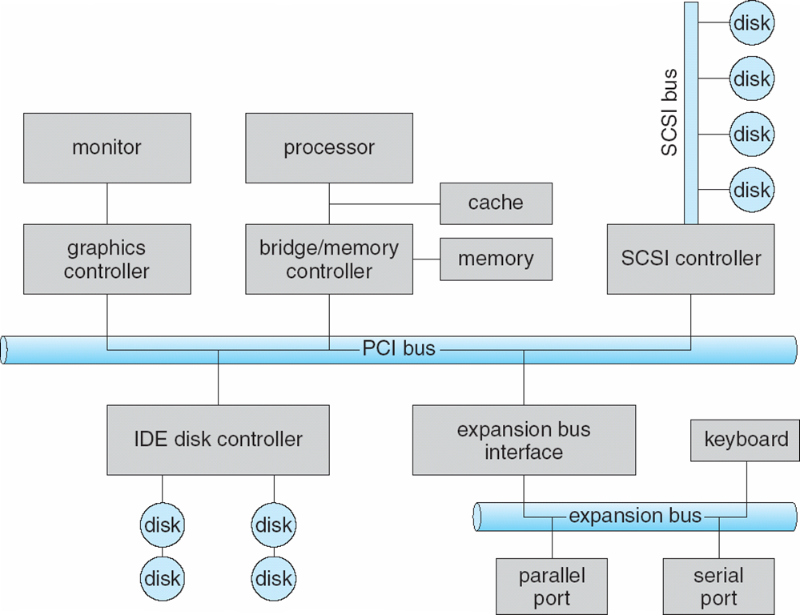
A Typical PC Bus Structure
SATA, PCIe bus ...

Slide 38
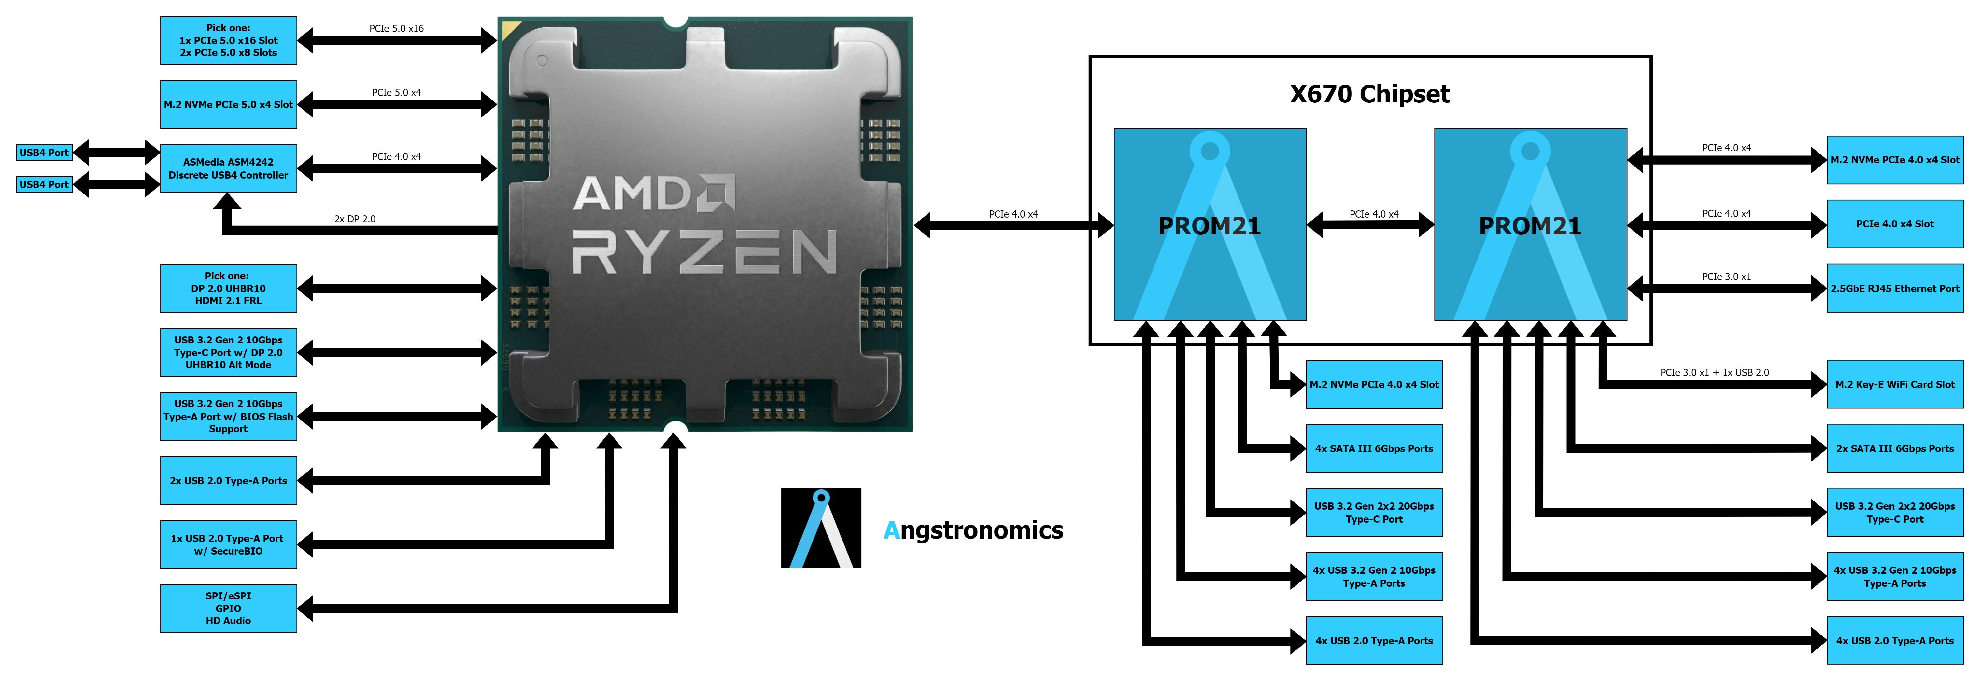
Typical configuration of X670E motherboard

Slide 39
I/O Hardware
I/O instructions control devices
Devices usually have registers where device driver places commands, addresses, and data to write, or read data from registers after command execution
Data-in register, data-out register, status register, control register
Typically 1-4 bytes, or FIFO buffer
Devices have addresses, used by
Direct I/O instructions
Memory-mapped I/O
Device data and command registers mapped to processor address space
Especially for large address spaces (graphics)

Slide 40
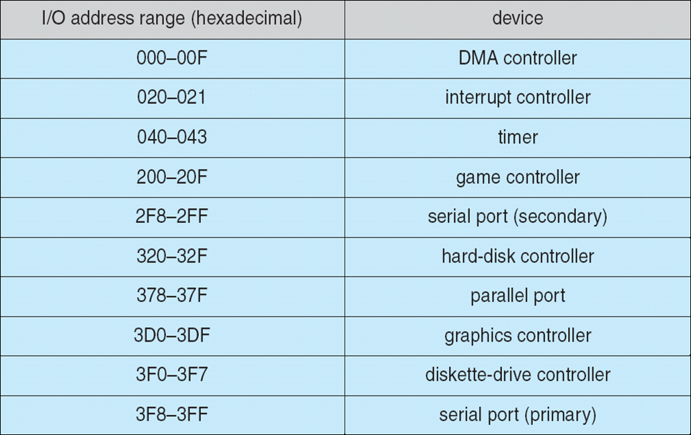
Device I/O Port Locations on PCs (partial)

Slide 41
Polling
For each byte of I/O
Read busy bit from status register until 0
Host sets read or write bit and if write copies data into data-out register
Host sets command-ready bit
Controller sets busy bit, executes transfer
Controller clears busy bit, error bit, command-ready bit when transfer done
Step 1 is busy-wait cycle to wait for I/O from device
Reasonable if device is fast
But inefficient if device slow
CPU switches to other tasks?
But if miss a cycle data overwritten / lost

Slide 42
Interrupts IRQ
CPU Interrupt-request line triggered by I/O device
Checked by processor after each instruction
Interrupt handler receives interrupts
Maskable to ignore or delay some interrupts
Interrupt vector to dispatch interrupt to correct handler
Context switch at start and end
Based on priority
Some nonmaskable
Interrupt chaining if more than one device at same interrupt number

Slide 43
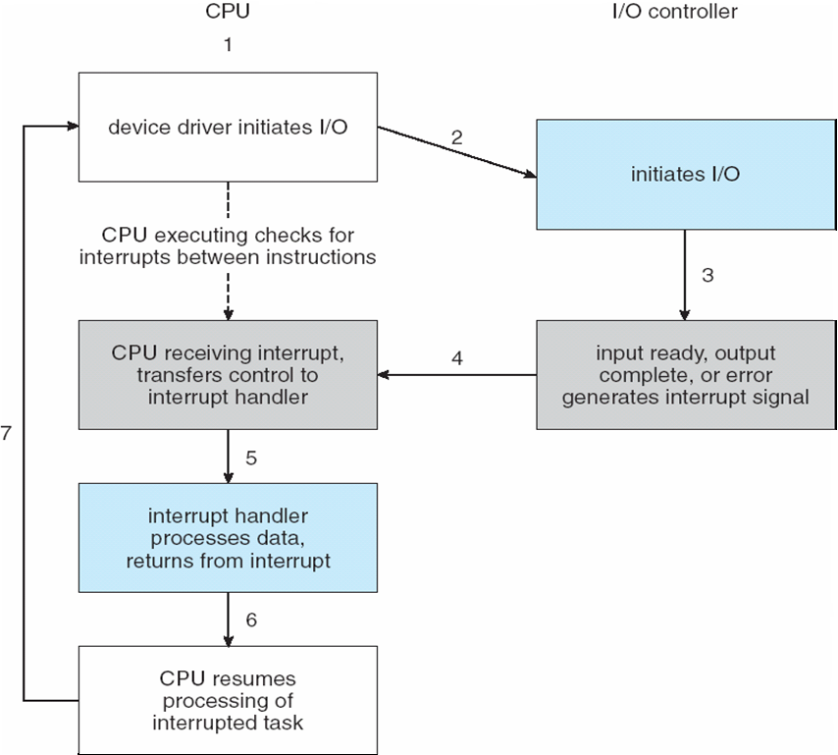
Interrupt-Driven I/O Cycle

Slide 44
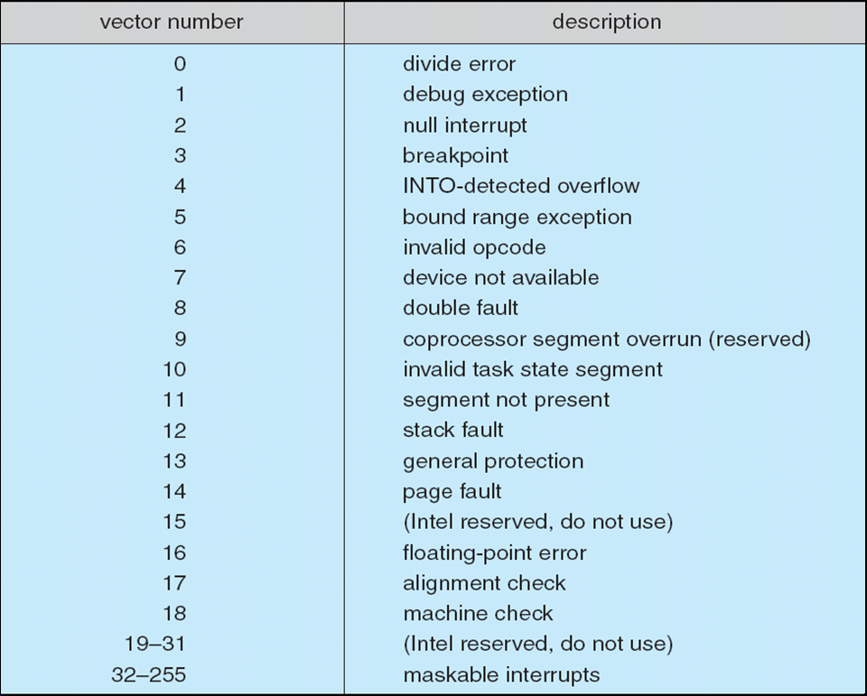
Intel Pentium Processor Event-Vector Table

Slide 45
Interrupts (Cont.)
Interrupt mechanism also used for exceptions
Terminate process, crash system due to hardware error
Page fault executes when memory access error
System call executes via trap to trigger kernel to execute request
Multi-CPU systems can process interrupts concurrently
If operating system designed to handle it
Used for time-sensitive processing, frequent, must be fast

Slide 46
Direct Memory Access
Used to avoid programmed I/O (one byte at a time) for large data movement
Requires DMA controller
Bypasses CPU to transfer data directly between I/O device and memory
OS writes DMA command block into memory
Source and destination addresses
Read or write mode
Count of bytes
Writes location of command block to DMA controller
Bus mastering of DMA controller – grabs bus from CPU
Cycle stealing from CPU but still much more efficient
When the DMA controller seizes the memory bus, the CPU is momentarily prevented from accessing main memory, although it can still access data items in its primary and secondary caches.
When done, interrupts to signal completion
Version that is aware of virtual addresses can be even more efficient - DVMA

Slide 47
Six Step Process to Perform DMA Transfer

Slide 48
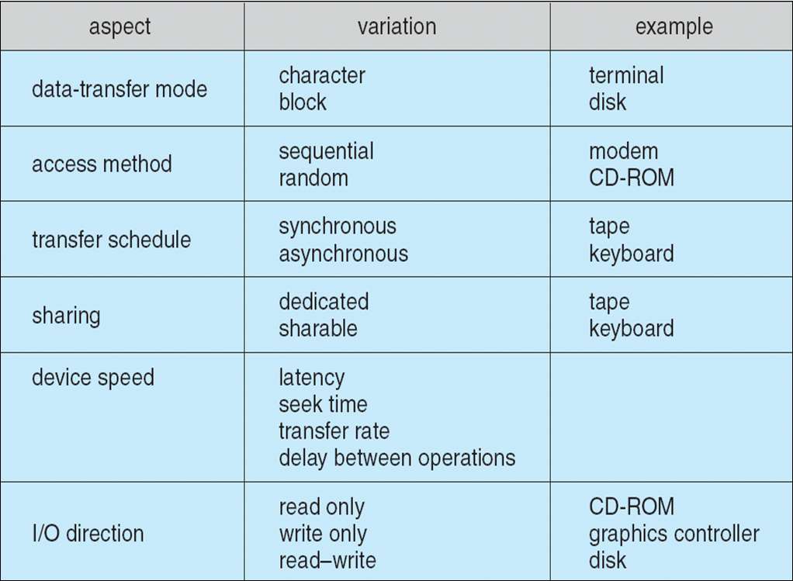
Application I/O Interface
I/O system calls encapsulate device behaviors in generic classes
Device-driver layer hides differences among I/O controllers from kernel
New devices talking already-implemented protocols need no extra work
Each OS has its own I/O subsystem structures and device driver frameworks
Devices vary in many dimensions
Character-stream or block
Sequential or random-access
Synchronous or asynchronous (or both)
Sharable or dedicated
Speed of operation
read-write, read only, or write only

Slide 49
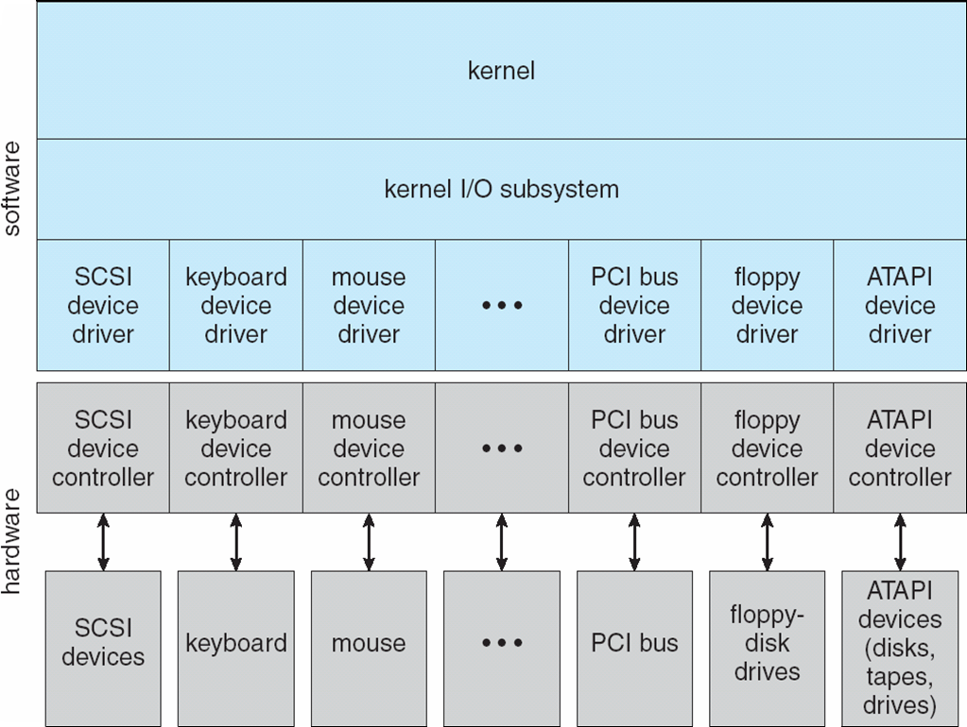
A Kernel I/O Structure

Slide 50
Block and Character Devices
Block devices include disk drives
Commands include read, write, seek
Raw I/O, direct I/O, or file-system access
Memory-mapped file access possible
File mapped to virtual memory and clusters brought via demand paging
DMA
Character devices include keyboards, mice, serial ports
Commands include get(), put()
Libraries layered on top allow line editing
In raw disk I/O, the process interacts with a physical device directly, without the kernel's brokerage.
data-critical applications - database engine
The primary benefit of direct I/O is to reduce CPU utilization for file reads and writes by eliminating the copy from the cache to the user buffer

Slide 51
Network Devices
Varying enough from block and character to have own interface
Linux, Unix, Windows and many others include socket interface
Separates network protocol from network operation
Includes select() functionality
Approaches vary widely (pipes, FIFOs, streams, queues, mailboxes)

Slide 52
Clocks and Timers
AMD procesory obsahujú rôzne časovače a timery, ktoré sú navrhnuté na efektívne riadenie výkonu a synchronizáciu, napr:
TSC (Time Stamp Counter): Tento časovač poskytuje vysokú presnosť a je používaný na meranie času medzi udalosťami. Je to 64-bitový register, ktorý sa neustále zvyšuje s každým taktom procesora.
HPET (High Precision Event Timer): Tento časovač je navrhnutý na poskytovanie presných časových údajov pre aplikácie, ktoré vyžadujú vysokú presnosť, ako sú multimediálne aplikácie.
APIC Timer (Advanced Programmable Interrupt Controller Timer): Používa sa na generovanie prerušení na základe časových intervalov, čo je užitočné pre multitasking a plánovanie úloh.
RTC (Real-Time Clock): Tento časovač je zodpovedný za sledovanie reálneho času, aj keď je systém vypnutý. Používa sa na udržiavanie systémového času.
SMU (System Management Unit) Timers: Tieto časovače sú súčasťou jednotky na správu systému a pomáhajú riadiť energetickú efektivitu a výkon procesora.
Provide current time, elapsed time, timer
Normal resolution about 1/60 second
Some systems provide higher-resolution timers
Programmable interval timer used for timings, periodic interrupts
ioctl() (on UNIX) covers odd aspects of I/O such as clocks and timers

Slide 53
Nonblocking and Asynchronous I/O
Blocking (Synchronous) - process suspended until I/O completed
Easy to use and understand
Insufficient for some needs
Nonblocking - I/O call returns as much as available
User interface, data copy (buffered I/O)
Implemented via multi-threading
Returns quickly with count of bytes read or written
select() to find if data ready then read() or write() to transfer
Asynchronous - process runs while I/O executes
Difficult to use
I/O subsystem signals process when I/O completed
Synchronné ovládače fungujú spôsobom, kde procesor čaká, kým sa vstupno-výstupná operácia úplne dokončí, než sa pustí do ďalších úloh. To znamená, že hlavný proces je „blokovaný“.
Asynchrónne ovládače umožňujú, aby procesor vykonával ďalšie úlohy, zatiaľ čo vstupno-výstupná operácia prebieha na pozadí. Používajú napríklad metódy ako prerušenia alebo callbacky.

Slide 54
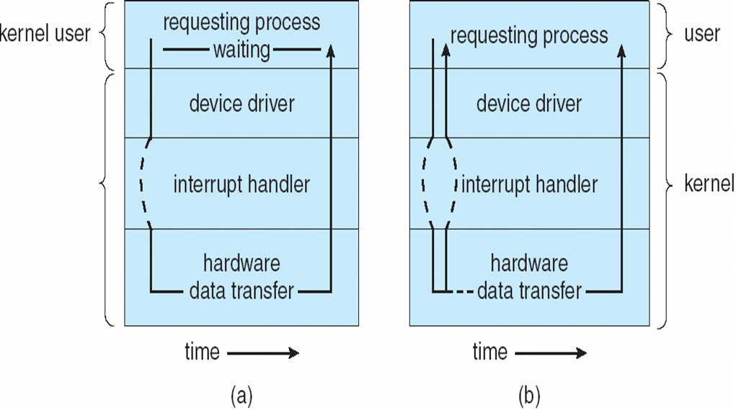
Two I/O Methods
Synchronous
Asynchronous

Slide 55
Vectored I/O
Vectored I/O, also known as scatter/gather I/O, is a technique used in computer systems for efficient input/output operations.
Definition: Instead of handling one contiguous block of data for input or output, vectored I/O allows data to be scattered from or gathered into multiple non-contiguous memory buffers in a single operation. (allows one system call to perform multiple I/O operations)
Key Benefits:
Performance Improvement: By reducing the number of I/O calls, it minimizes overhead and enhances performance, especially for large or fragmented data.
Flexibility: It’s particularly useful for applications where data is naturally stored in multiple non-adjacent memory locations (e.g., network stacks, file systems).
Applications:
Networking: Vectored I/O is commonly used in protocols like TCP/IP to manage fragmented packets efficiently.
File Operations: File systems that manage scattered chunks of data can use vectored I/O for reading and writing without the need for intermediate data copying.

Slide 56
Kernel I/O Subsystem
Kernels provide many services related to I/O build on the hardware and devicedriver infrastructure
scheduling
buffering
caching
spooling
device reservation
error handling
The I/O subsystem is also responsible for protecting itself from errant processes and malicious users

Slide 57
Kernel I/O Subsystem
Scheduling
Some I/O request ordering via per-device queue
Some OSs try fairness
Some implement Quality Of Service (i.e. IP QoS)
Buffering - store data in memory while transferring between devices
To cope with device speed mismatch
To cope with device transfer size mismatch
To maintain “copy semantics”
Double buffering – two copies of the data
Kernel and user
Varying sizes
Full / being processed and not-full / being used
Copy-on-write can be used for efficiency in some cases

Slide 58
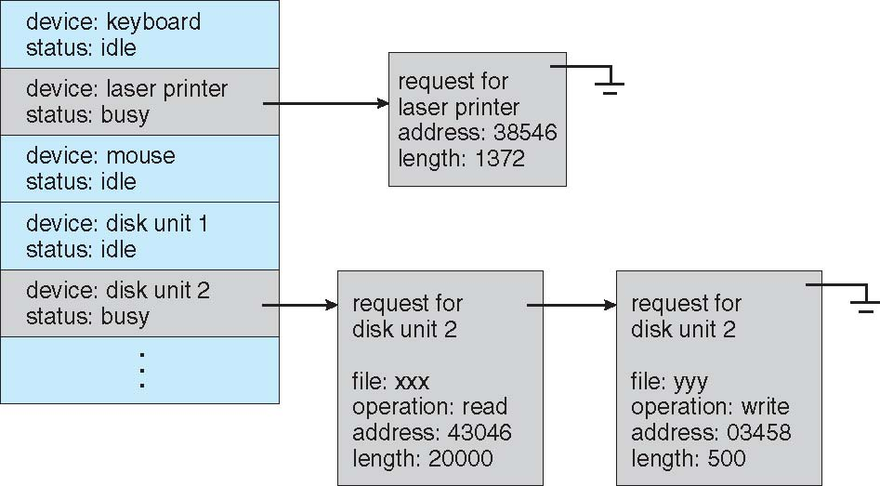
Device-status Table

Slide 59
AMD Ryzen X670E motherboard with X670 Chipset
Typ rozhrania | Max. teoretická rýchlosť | Typické reálne rýchlosti zariadení | Príklady zariadení
PCIe 5.0 x16 (GPU) | ~64 GB/s (32 GT/s ×16) | GPU nevyužívajú celé pásmo; výkon sa meria FPS, nie priamym prenosom dát | NVIDIA RTX 4090; AMD RX 7900 XTX
PCIe 4.0 x4 (NVMe SSD) | ~8 GB/s | 6–7.5 GB/s pri kvalitných Gen4 SSD | Samsung 980 Pro; WD Black SN850
PCIe 3.0 x1 | ~1 GB/s | 600–900 MB/s pri PCIe kartách | zvukové/sieťové/capture PCIe karty
M.2 PCIe 5.0 x4 (NVMe) | ~16 GB/s | 10–12+ GB/s (tepelný limit závisí od chladenia) | Crucial T700; Corsair MP700
M.2 PCIe 4.0 x4 | ~8 GB/s | 6–7.5 GB/s | Kingston KC3000; WD SN850X
SATA 6 Gb/s | ~600 MB/s | 450–550 MB/s (SATA SSD); 100–200 MB/s (HDD) | Crucial MX500; WD Blue HDD
USB 20 Gb/s (USB 3.2 Gen 2x2) | 20 Gb/s (~2.5 GB/s) | 1.8–2.2 GB/s (externé NVMe) | SanDisk Extreme Pro v2; Sabrent Rocket Nano V2
USB 10 Gb/s (USB 3.2 Gen 2) | 10 Gb/s (~1.25 GB/s) | 800–1100 MB/s (externé NVMe) | Samsung T7; Crucial X8
USB 5 Gb/s (USB 3.2 Gen 1) | 5 Gb/s (~625 MB/s) | 300–450 MB/s (USB SSD); 50–150 MB/s (USB HDD) | WD MyPassport; SanDisk Extreme Portable
USB 2.0 | 480 Mb/s (~60 MB/s) | 20–35 MB/s | Myš, klávesnica, staršie USB kľúče
LAN 2.5 GbE | 2.5 Gb/s (~312 MB/s) | 250–295 MB/s | 2.5G NAS, PC s 2.5GbE
Wi‑Fi 6E | ~2.4 Gb/s (teoreticky) | 800–1200 Mb/s pri 6 GHz s kvalitným signálom | Routery Asus/TP‑Link Wi‑Fi 6E; klientske adaptéry Intel/MediaTek

Slide 60
Kernel I/O Subsystem
Key Difference:
Caching improves performance by speeding up repeated access to the same data.
Buffering ensures efficiency and continuity when there is a mismatch in speed between data producers and consumers.
Both are essential for optimizing system performance but tackle different challenges!
Caching - faster device holding copy of data
Always just a copy
Key to performance
Sometimes combined with buffering
Spooling - hold output for a device
If device can serve only one request at a time
i.e., Printing
Device reservation - provides exclusive access to a device
System calls for allocation and de-allocation
Watch out for deadlock

Slide 61
Kernel I/O Subsystem
Error Handling
OS can recover from disk read, device unavailable, transient write failures
Retry a read or write, for example
Some systems more advanced – Solaris FMA, AIX
Track error frequencies, stop using device with increasing frequency of retry-able errors
Most return an error number or code when I/O request fails
System error logs hold problem reports

Slide 62
I/O Protection
Use of a System Call to Perform I/O
User process may accidentally or purposefully attempt to disrupt normal operation via illegal I/O instructions
All I/O instructions defined to be privileged
I/O must be performed via system calls
Memory-mapped and I/O port memory locations must be protected too

Slide 63
Kernel Data Structures
Kernel keeps state info for I/O components, including:
open file tables
network connections
character device state
Many complex data structures to track buffers, memory allocation, “dirty” blocks
Some use object-oriented methods and message passing to implement I/O
Windows uses message passing
Message with I/O information passed from user mode into kernel
Message modified as it flows through to device driver and back to process
Pros / cons?

Slide 64
UNIX I/O Kernel Structure

Slide 65
Power Management
Not strictly domain of I/O, but much is I/O related
Computers and devices use electricity, generate heat, frequently require cooling
OSes can help manage and improve use
Cloud computing environments move virtual machines between servers
Can end up evacuating whole systems and shutting them down
Mobile computing has power management as first class OS aspect
For example, Android implements
Component-level power management
Understands relationship between components
Build device tree representing physical device topology
System bus -> I/O subsystem -> {flash, USB storage}
Device driver tracks state of device, whether in use
Unused component – turn it off
All devices in tree branch unused – turn off branch
Wake locks – like other locks but prevent sleep of device when lock is held
Power collapse – put a device into very deep sleep
Marginal power use
Only awake enough to respond to external stimuli (button press, incoming call)

Slide 66
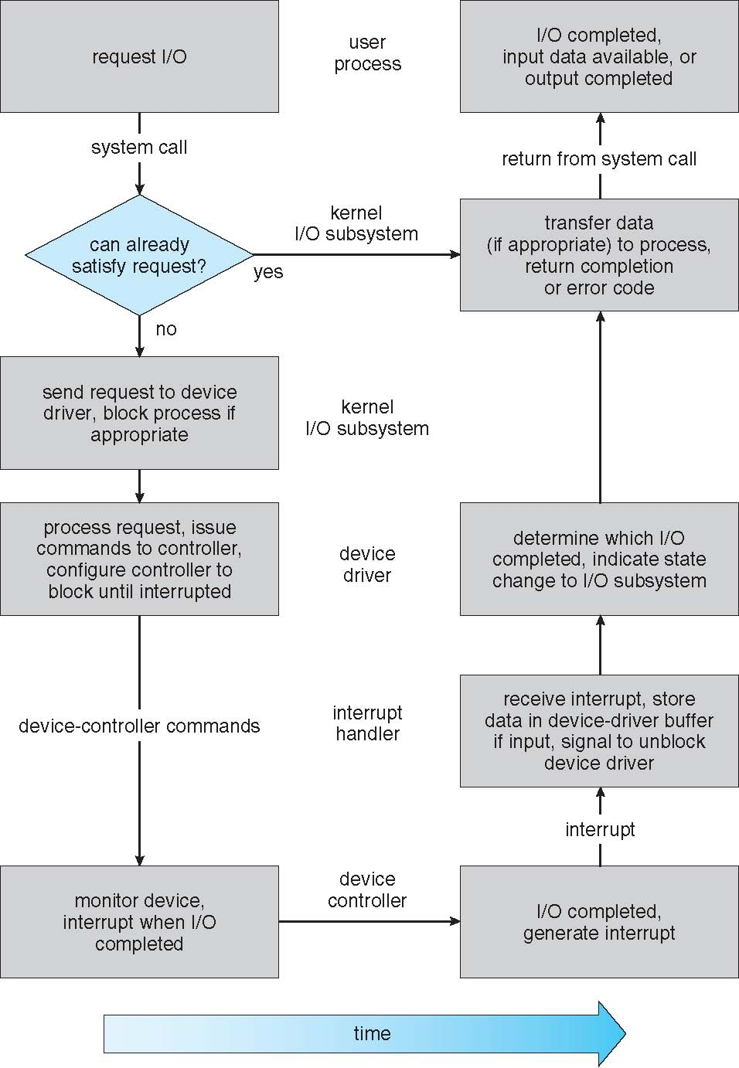
I/O Requests to Hardware Operations
Consider reading a file from disk for a process:
Determine device holding file
Translate name to device representation
Physically read data from disk into buffer
Make data available to requesting process
Return control to process

Slide 67
Intercomputer Communications

Slide 68
STREAMS
STREAM – a full-duplex communication channel between a user-level process and a device in Unix System V and beyond
A STREAM consists of:
- STREAM head interfaces with the user process
- driver end interfaces with the device - zero or more STREAM modules between them
Each module contains a read queue and a write queue
Message passing is used to communicate between queues
Flow control option to indicate available or busy
Asynchronous internally, synchronous where user process communicates with stream head

Slide 69
Performance
I/O a major factor in system performance:
Demands CPU to execute device driver, kernel I/O code
Context switches due to interrupts
Data copying
Network traffic especially stressful

Slide 70
Improving I/O Performance
Reduce number of context switches
Reduce data copying
Reduce interrupts by using large transfers, smart controllers, polling
Use DMA
Use smarter hardware devices
Balance CPU, memory, bus, and I/O performance for highest throughput
Move user-mode processes / daemons to kernel threads

Slide 71
Device-Functionality Progression
The development of new I/O algorithms often follows a progression from application level code to on-board hardware implementation, as shown in Figure
Lower-level implementations are faster and more efficient, but higher-level ones are more flexible and easier to modify.
Hardware-level functionality may also be harder for higher-level authorities ( e.g. the kernel ) to control.

Slide 72

Záver
Otázky ?

